Slide 1
Math 769: Statistical Learning

Slide 2
Smoothing Splines
Shahrzad Jamshidi, PhD

Slide 3
Last Module
We studied piecewise polynomials, also called splines.
Cubic splines are the most common form.
These have the property that their first three derivatives match up at the end points of each piece, giving a smoother look.
The python package in SciPy does not allow us to pick these intervals.

Slide 4
Objectives
Describe the motivation of smoothing splines
Define a natural cubic spline.
Define the roughness penalty.

Slide 5
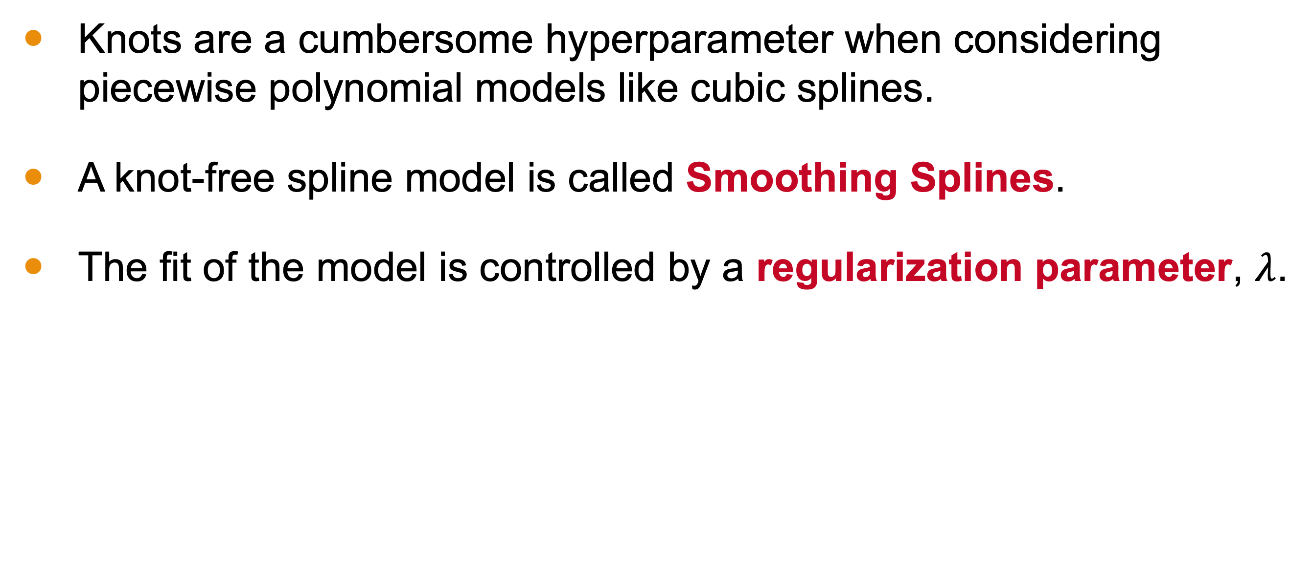
Knot-Free Splines
Knots are a cumbersome hyperparameter when considering piecewise polynomial models like cubic splines.
A knot-free spline model is called Smoothing Splines.
The fit of the model is controlled by a regularization parameter, $λ$.

Slide 6
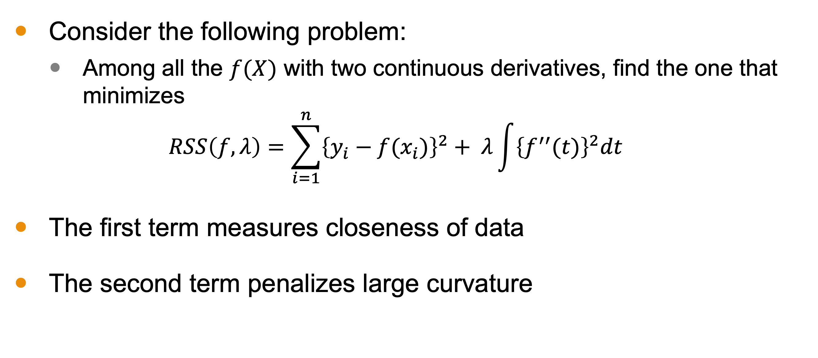
Smoothing Splines Motivation
Consider the following problem:
Among all the $f(X)$ with two continuous derivatives, find the one that minimizes
$$RSS\left(f,λ\right)=\sum_{i=1}^{n}{{\left\{y_{i}−f(x_{i})\right\}}^{2}+ λ\int{{\left\{f^{′′}(t)\right\}}^{2}dt}}$$
The first term measures closeness of data
The second term penalizes large curvature

Slide 7
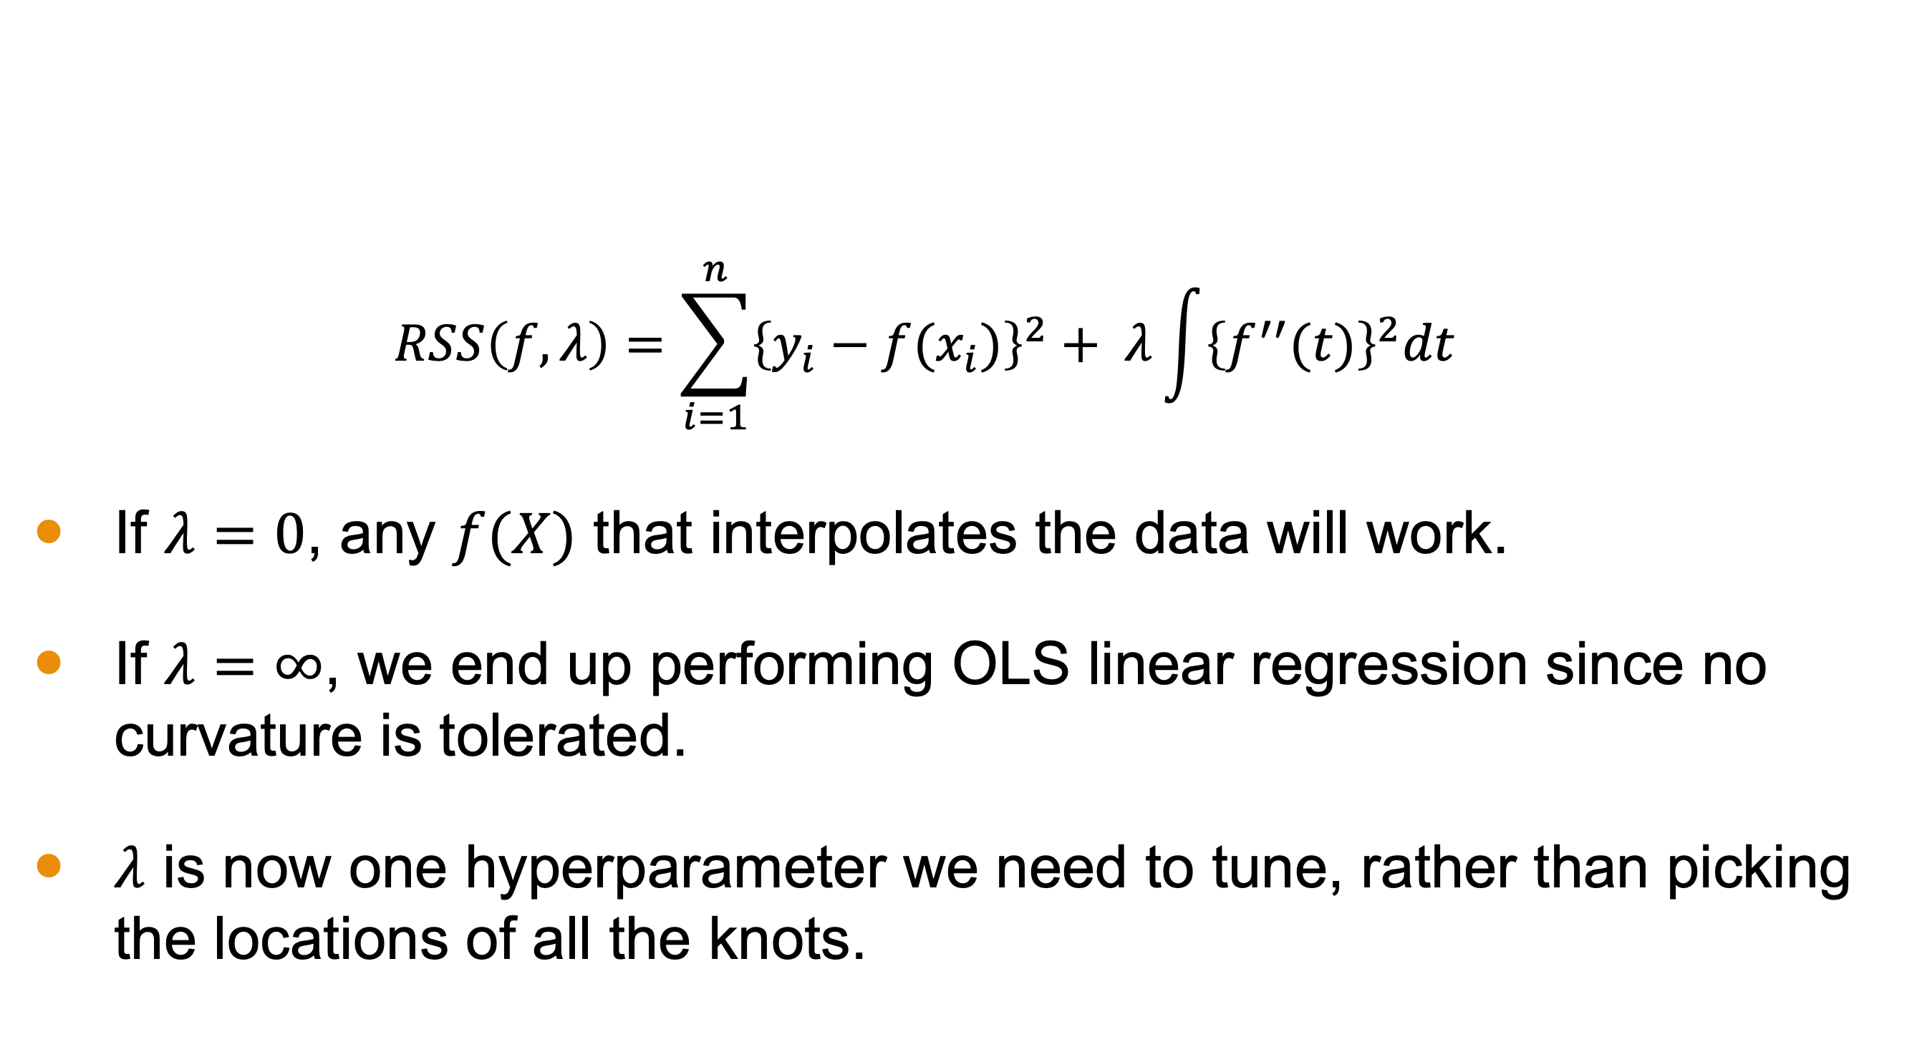
Smoothing Splines Motivation
$$RSS\left(f,λ\right)=\sum_{i=1}^{n}{{\left\{y_{i}−f(x_{i})\right\}}^{2}+ λ\int{{\left\{f^{′′}(t)\right\}}^{2}dt}}$$
If $λ=0$, any $f(X)$ that interpolates the data will work.
If $λ=∞$, we end up performing OLS linear regression since no curvature is tolerated.
$λ$ is now one hyperparameter we need to tune, rather than picking the locations of all the knots.

Slide 8
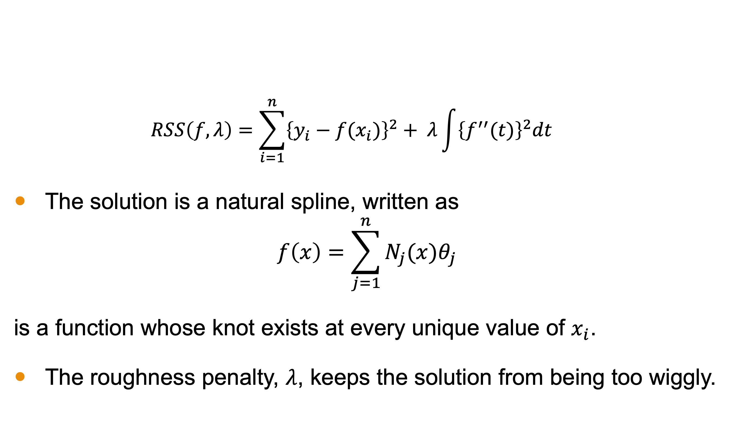
Natural Spline
$$RSS\left(f,λ\right)=\sum_{i=1}^{n}{{\left\{y_{i}−f(x_{i})\right\}}^{2}+ λ\int{{\left\{f^{′′}(t)\right\}}^{2}dt}}$$
The solution is a natural spline, written as
$$f\left(x\right)=\sum_{j=1}^{n}{N_{j}(x)θ_{j}}$$
is a function whose knot exists at every unique value of $x_{i}$.
The roughness penalty, $λ$, keeps the solution from being too wiggly.

Slide 9
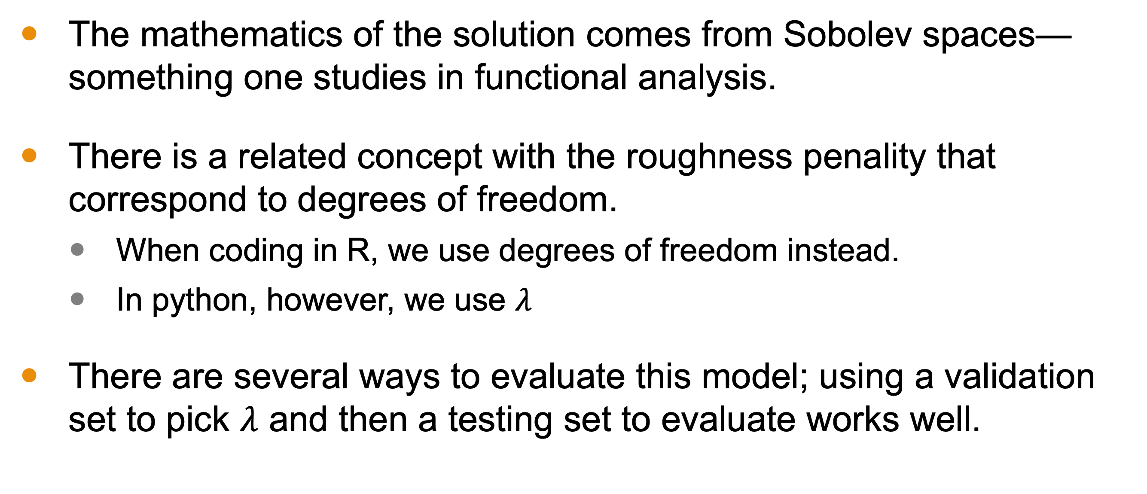
Natural Cubic Spline
The mathematics of the solution comes from Sobolev spaces—something one studies in functional analysis.
There is a related concept with the roughness penality that correspond to degrees of freedom.
When coding in R, we use degrees of freedom instead.
In python, however, we use $λ$
There are several ways to evaluate this model; using a validation set to pick $λ$ and then a testing set to evaluate works well.

Slide 10
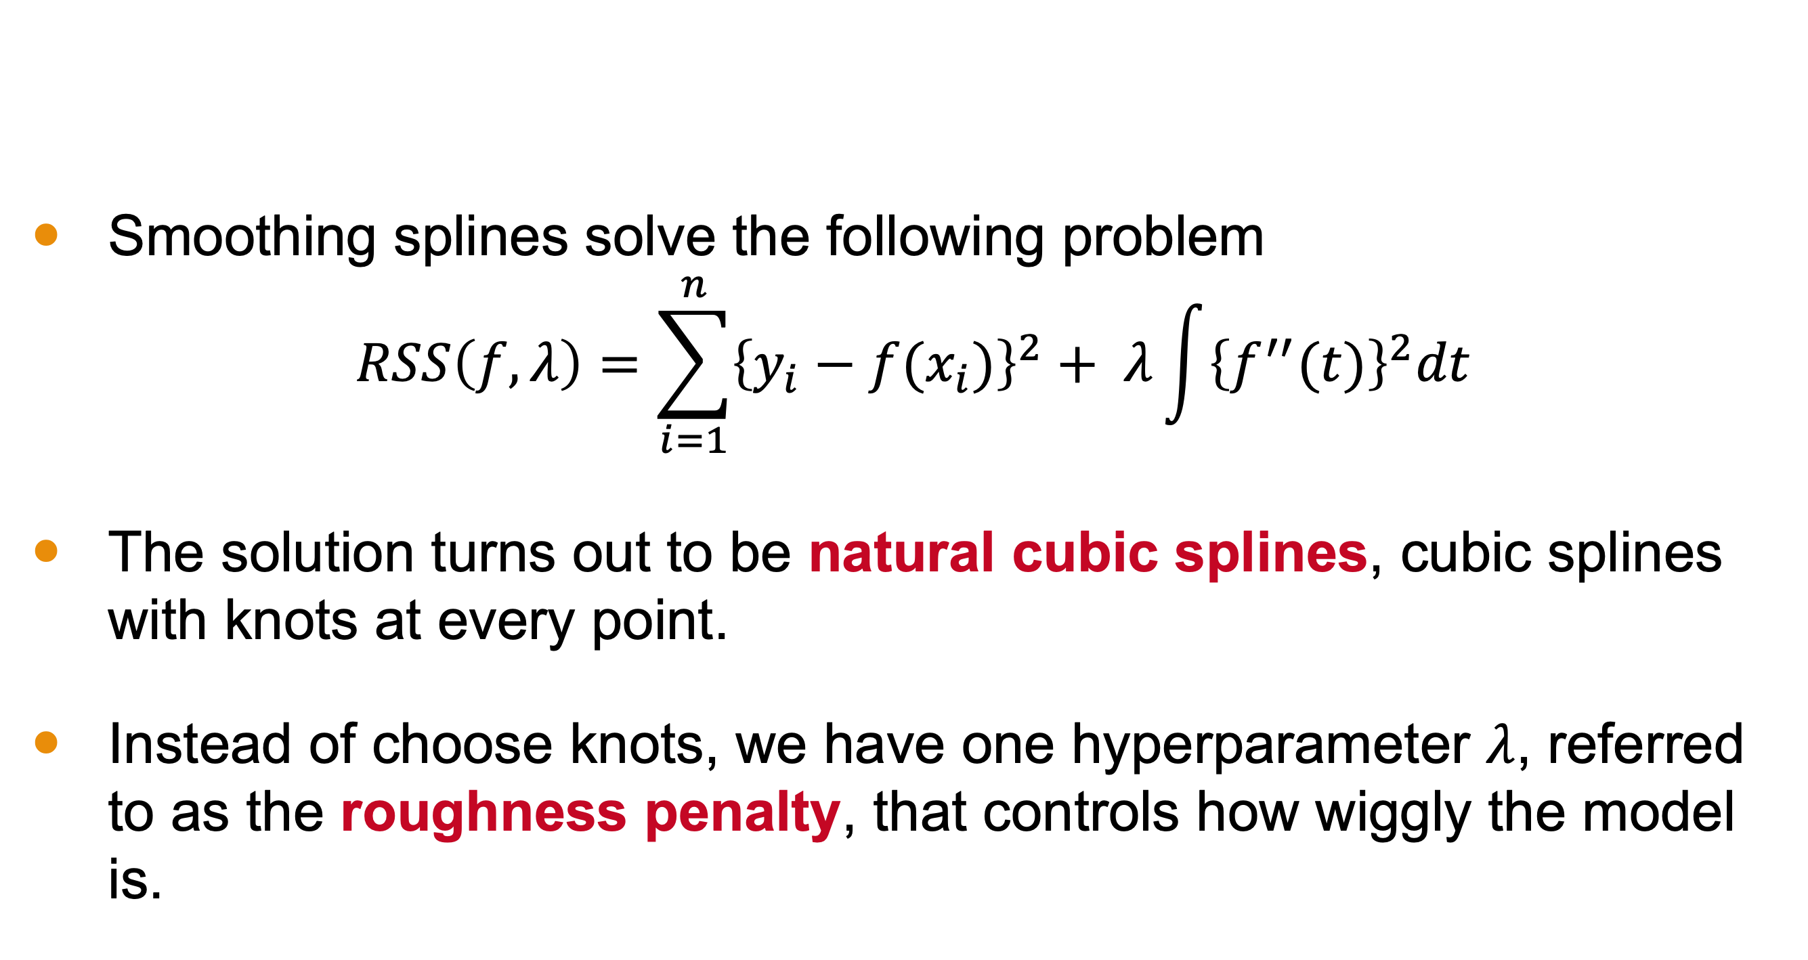
Conclusion
Smoothing splines solve the following problem
$$RSS\left(f,λ\right)=\sum_{i=1}^{n}{{\left\{y_{i}−f(x_{i})\right\}}^{2}+ λ\int{{\left\{f^{′′}(t)\right\}}^{2}dt}}$$
The solution turns out to be natural cubic splines, cubic splines with knots at every point.
Instead of choose knots, we have one hyperparameter $λ$, referred to as the roughness penalty, that controls how wiggly the model is.

